Slide 1

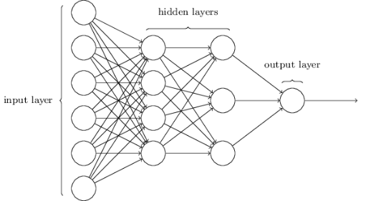

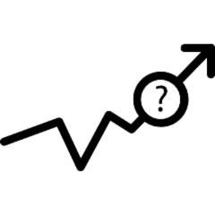



Literature Review
Artificial Neural Network
Questionnaires
Feasibility Analysis
Surveys Dataset
Micro Hydro Power Plants
Surveys

